Slide 1

PopMatic
This project envisions the future of automated PopCorn and production facilities. It will help create a more efficient and high-quality procedure.
Presented by Anwar Baker & Yazan Saleh
Supervised by Dr. Loay Malhis
A graduation project that took place at An-Najah National University

Slide 2





WHAT
1
2
3
4
5
6
Main idea
Hardware Components
WILL WE
COVER
Features
Challenges
Future Work
Q&A
0-1

Slide 3
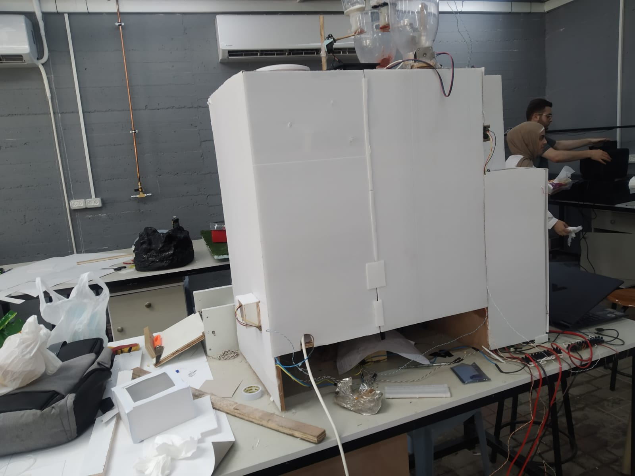
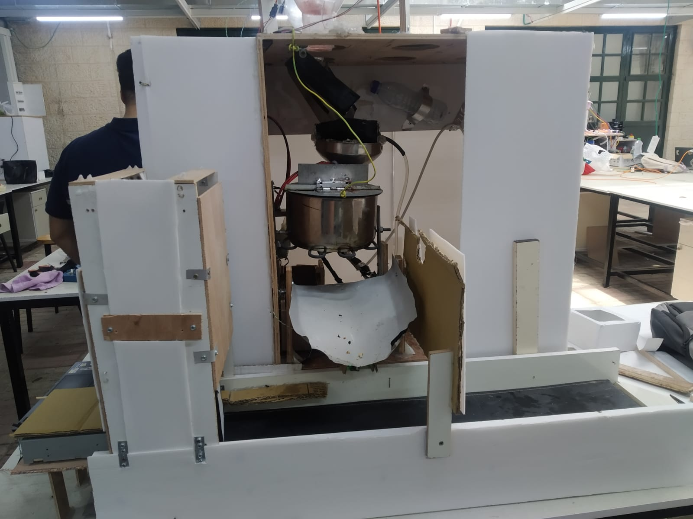
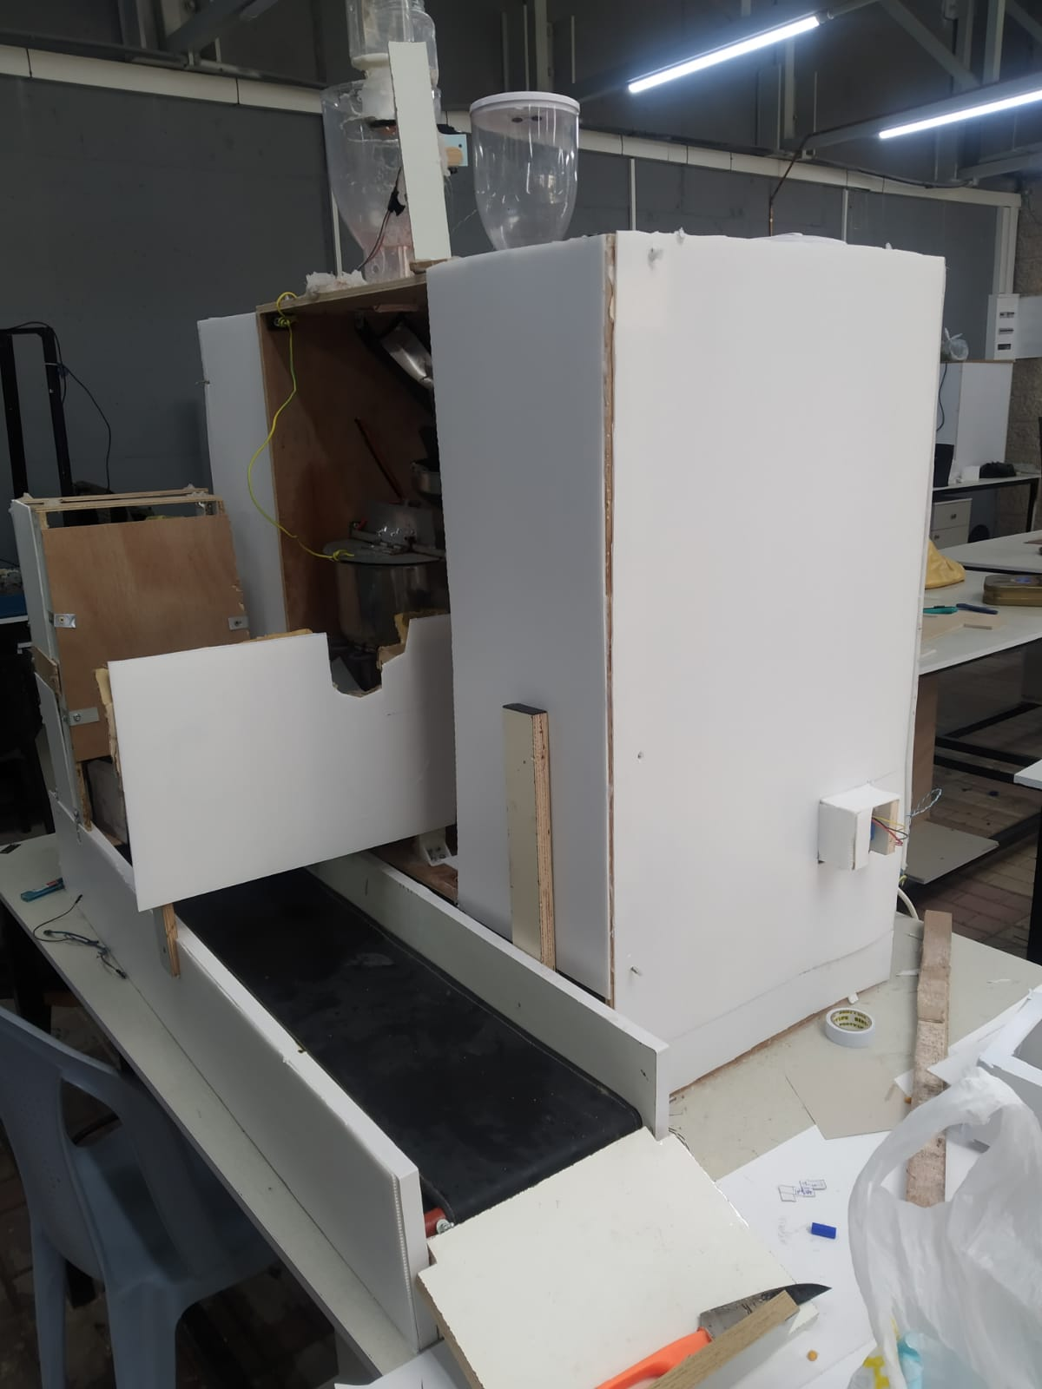
Our Project
1-1

Slide 4
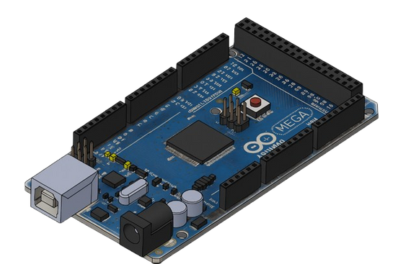
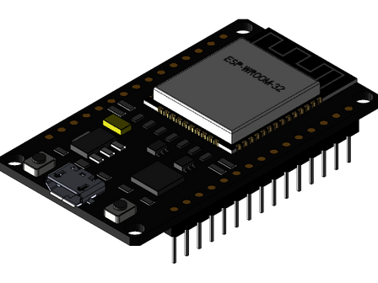

Hardware Components
Control Units
Arduino Mega 2560
ESP-32
Arduino IDE
2-1

Slide 5
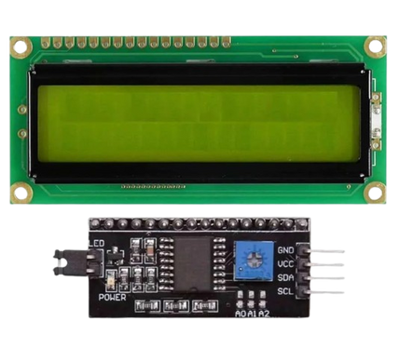
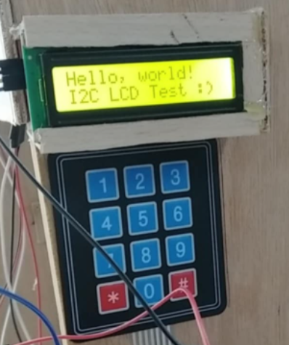
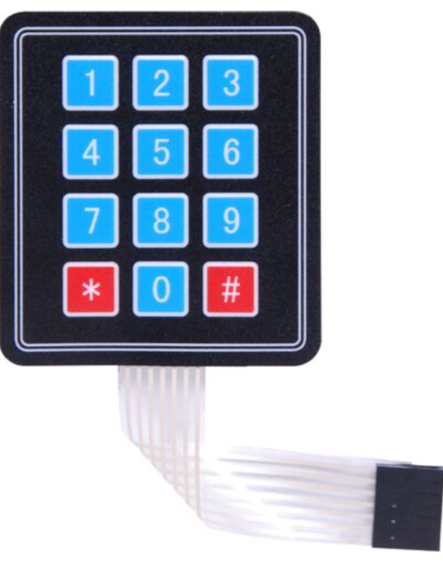
LCD 2X16
Keypad 3x4
2-2

Slide 6

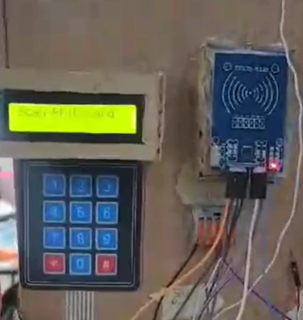
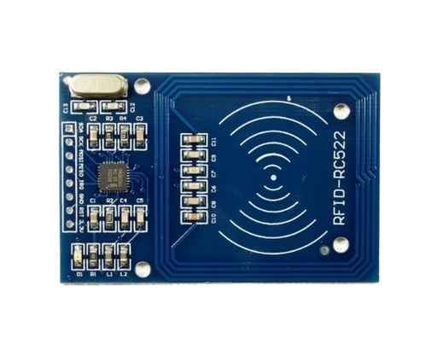

RFID
Customer Card
2-3

Slide 7

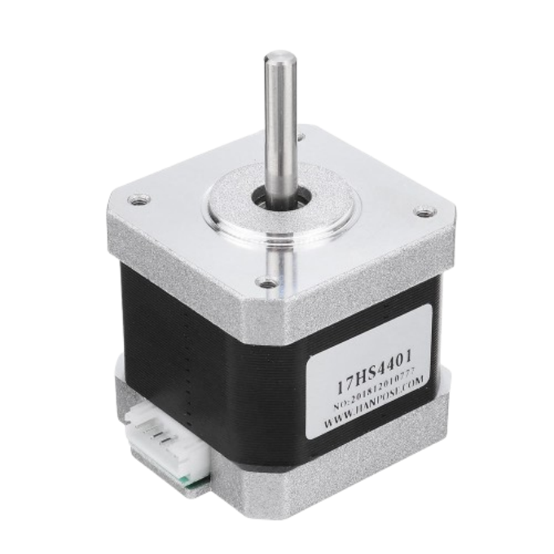
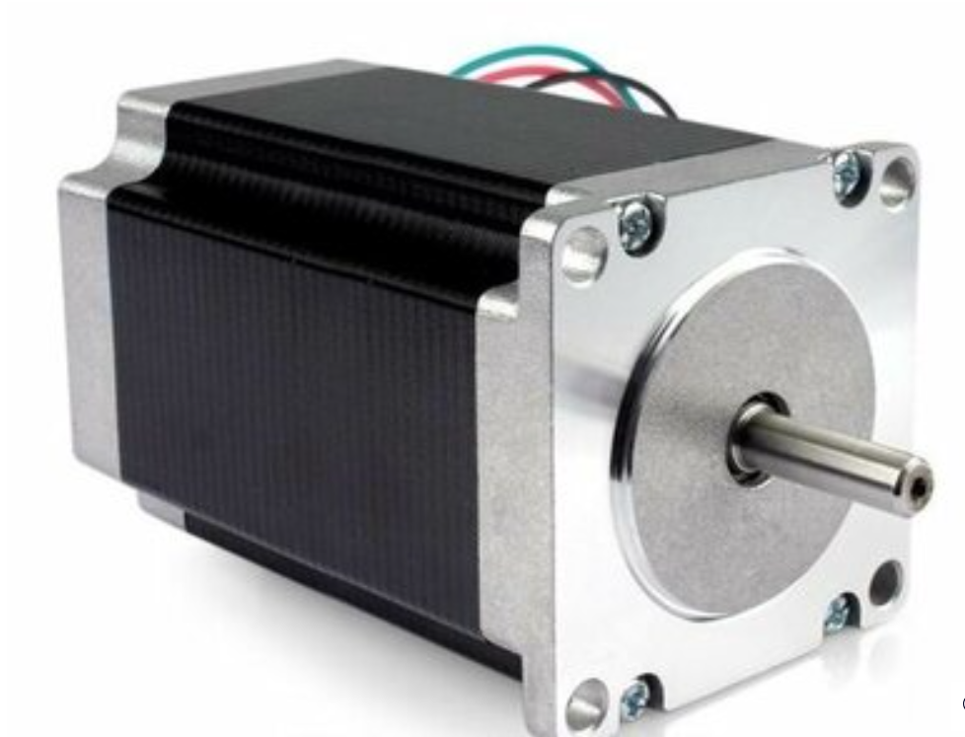
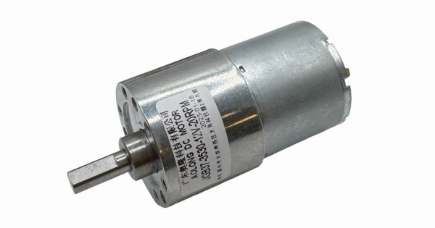
Motors
Stepper Motor Nema 17
Stepper Motor Nema 23
DC Motor
2-4

Slide 8
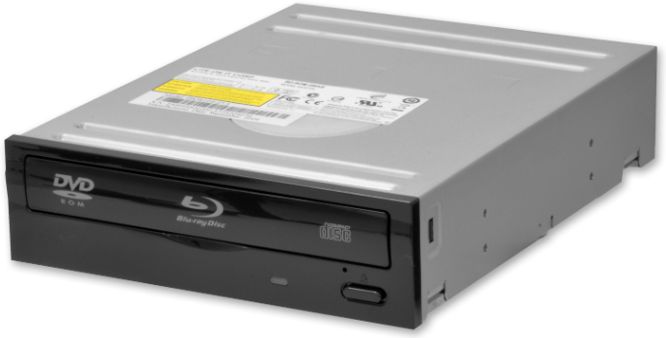
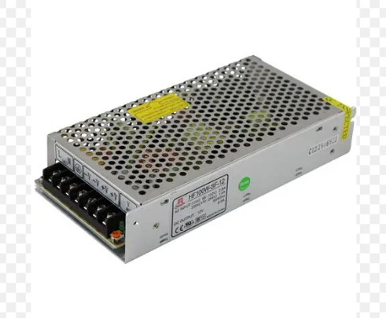
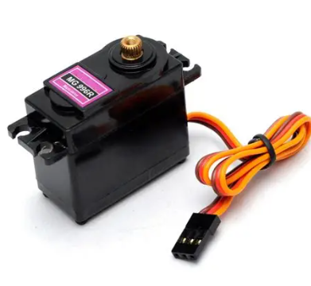
Motors
12V Power Supply
Two Servos Motor 5v
DVD DRIVER
2-4

Slide 9

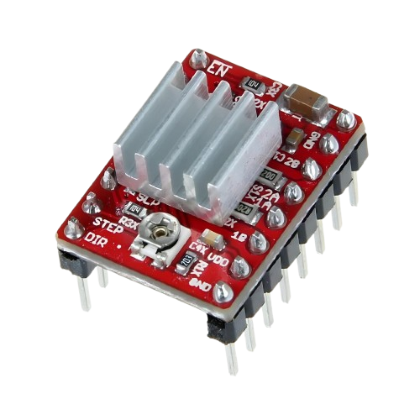
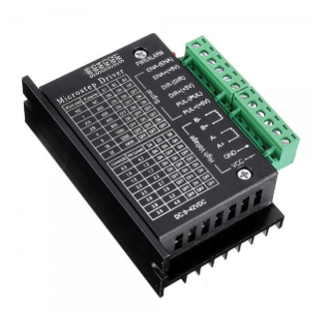
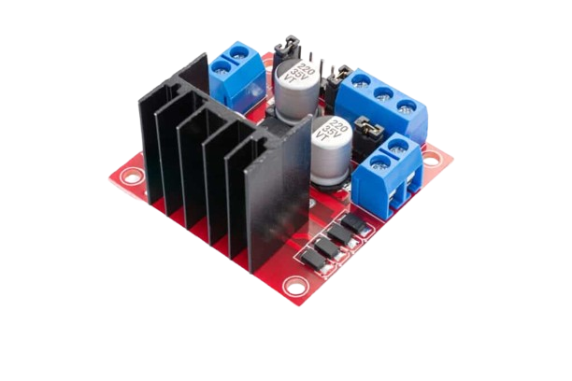

A4988 Stepper Motor Driver‏
TB6600 Driver
L298N Dual H-Bridge Driver Module‏
See more

Slide 10

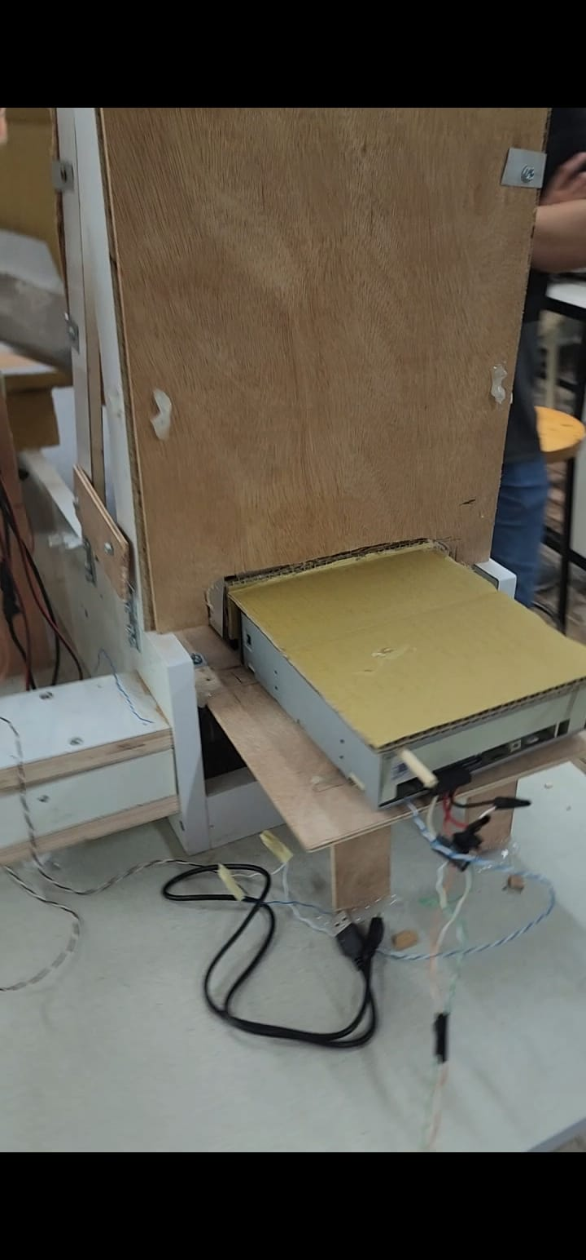
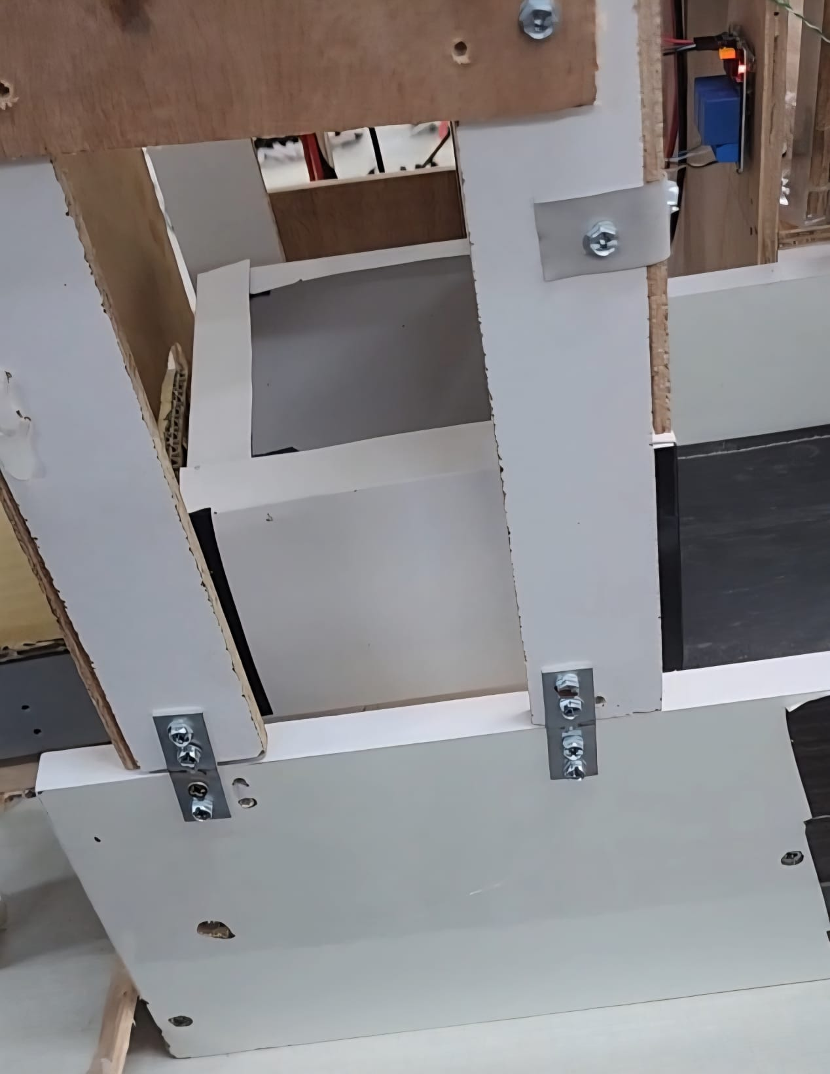
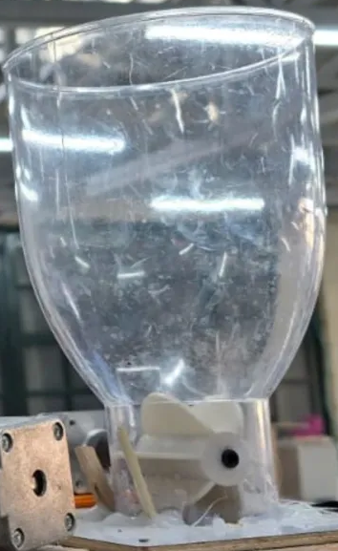
Container
Dispenser
Corn
Dispenser
2-6

Slide 11
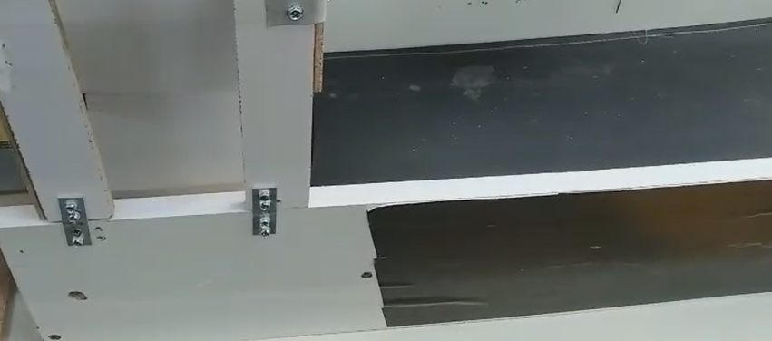
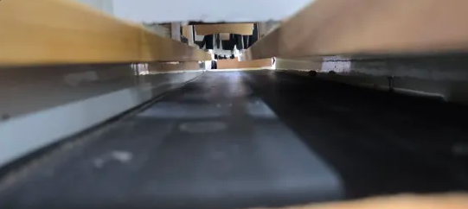

Conveyor Belt
2-7

Slide 12

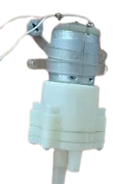
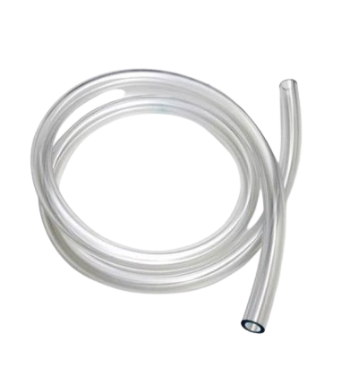
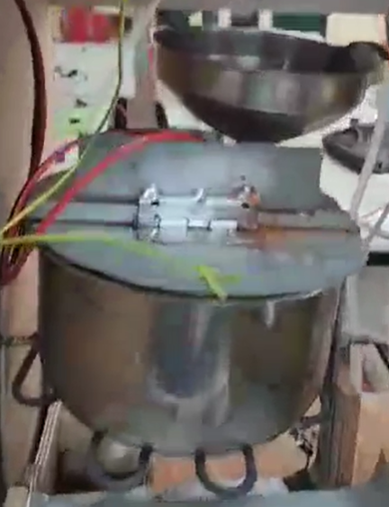

Pump
Pipes
Pot with Heater
2-8

Slide 13
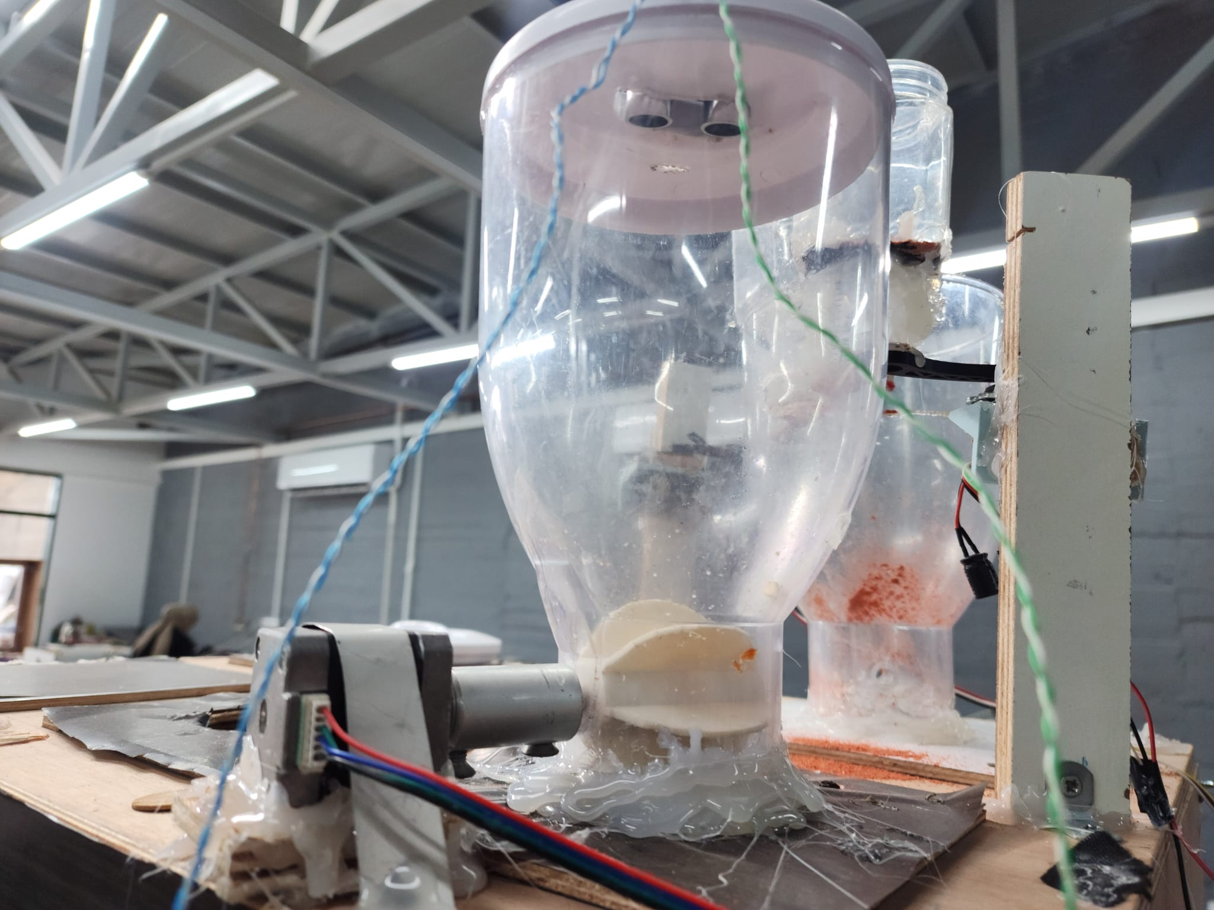
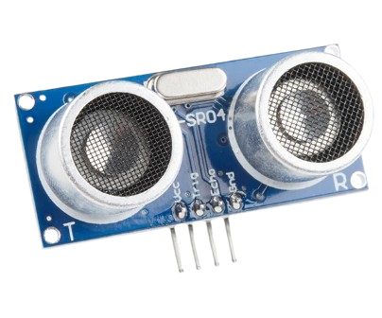
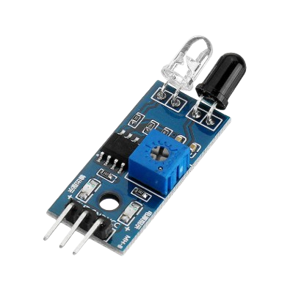
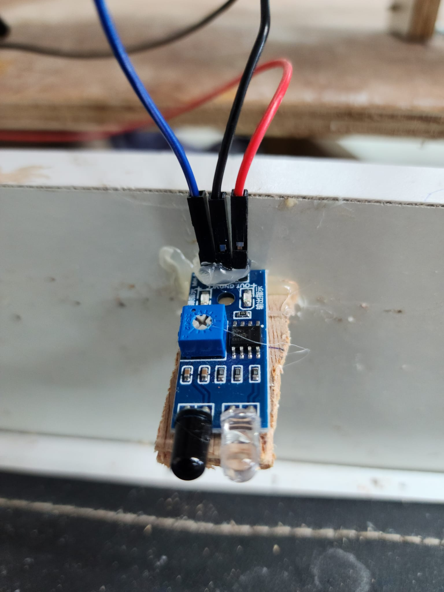
Sensors
Ultrasonic
IR
2-9

Slide 14


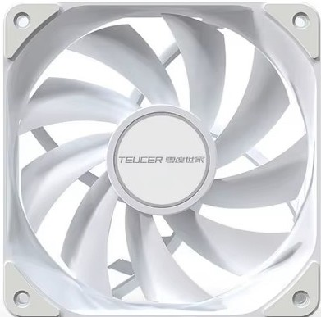
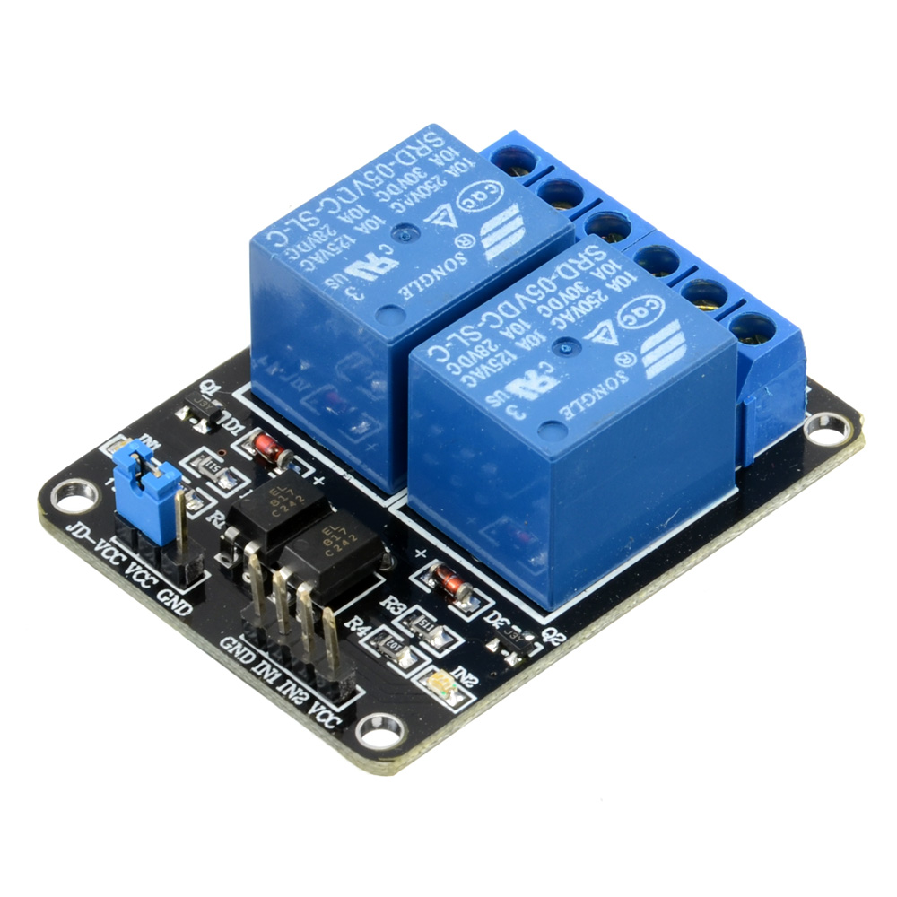
12v Fan for cleaning
Two Channel 5V Relay Module

Slide 15
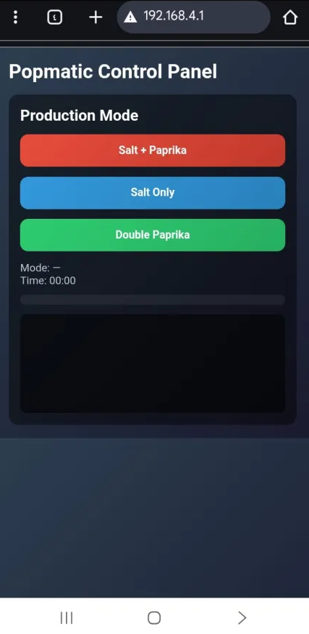

Features
VS Code
Wep Development
3-1

Slide 16


Features
Payment before order using RFID
3-1

Slide 17

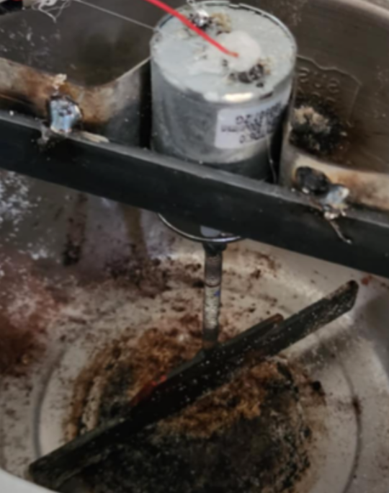
Automated Mixing
Dc motor to mix the PopCorn with Flavors
3-3

Slide 18
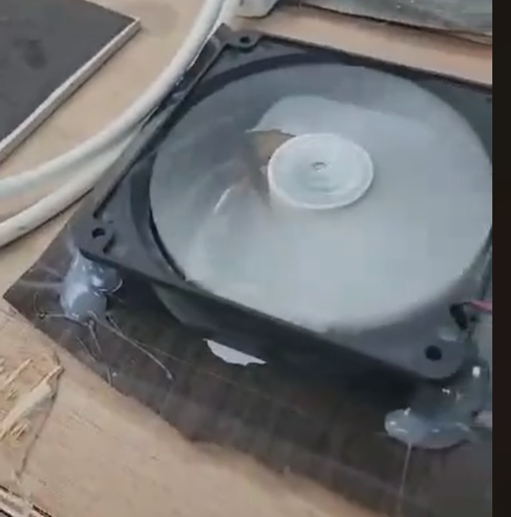
smoke cleaning
Fan for smoke extraction
3-3

Slide 19
Challenges
1- Short Development Timeline
2- Imagine the design of the pot that will be used.
4-1

Slide 20
Challenges
3-The first pot failed, which wasted about two weeks of the semester.
4- There wasn't enough space for the ready-made cup dispenser, so we lost more time designing our own dispenser.
4-1

Slide 21
Future Work
increase number of flavors
1
2
Add Cleaning Tool inside the pot
5-1

Slide 22
Future Work
Add more than one size of cups
3
6-1

Slide 23
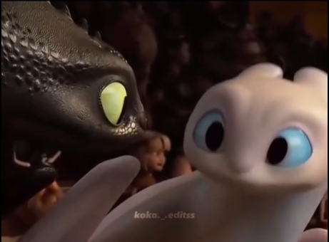
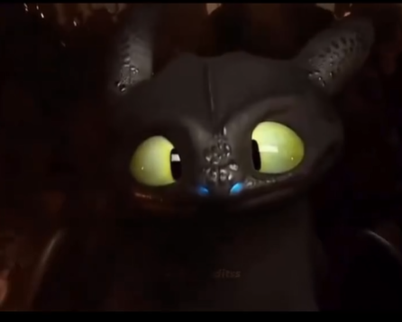
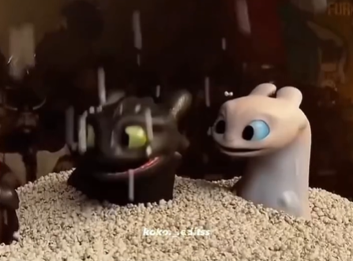

Thanks For Your Attention
Any
Questions ?

